Slide 1


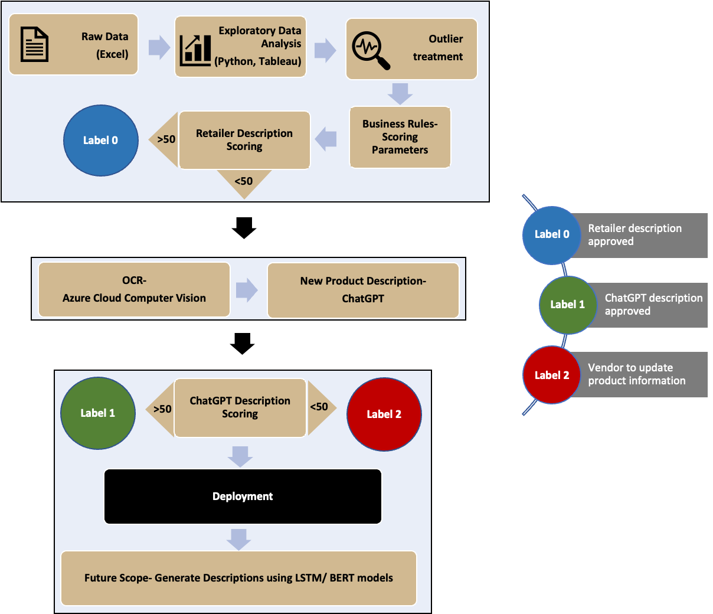





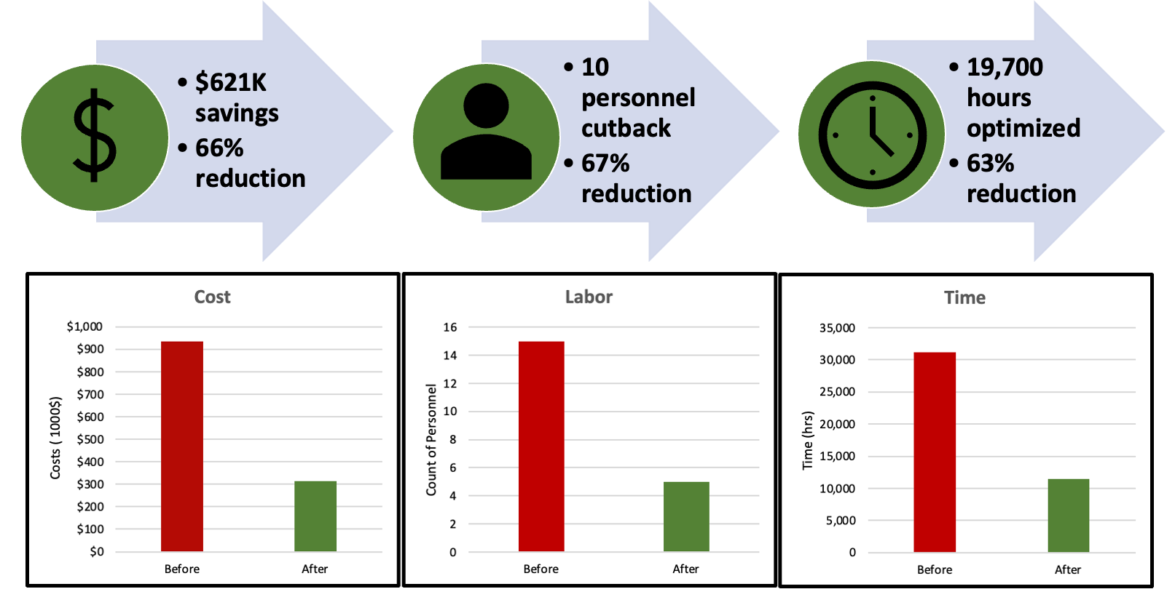

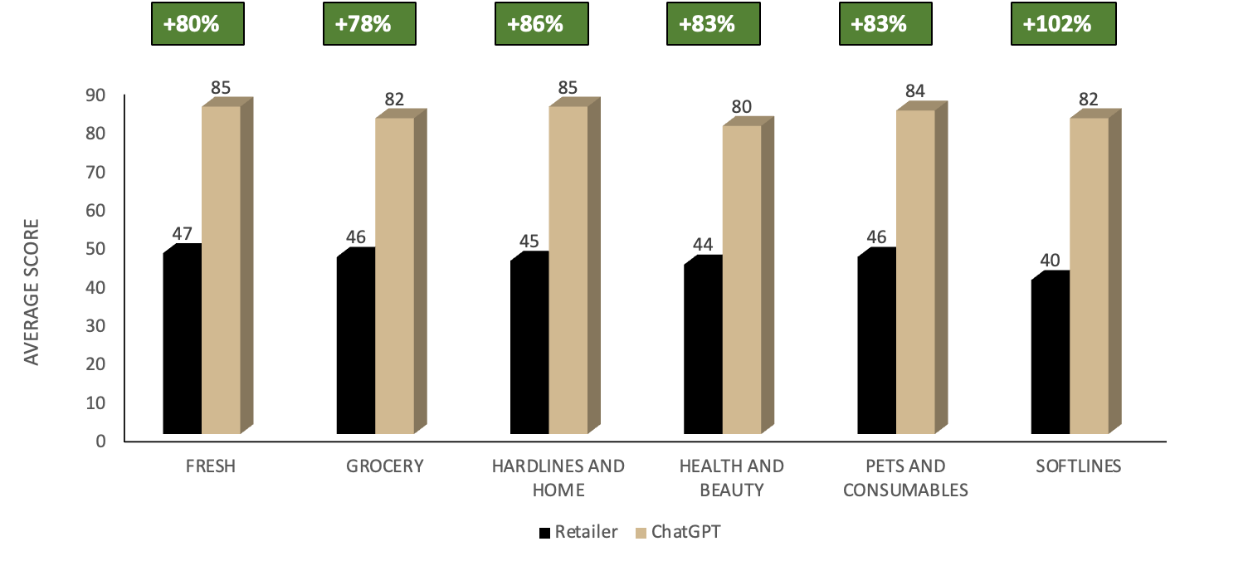
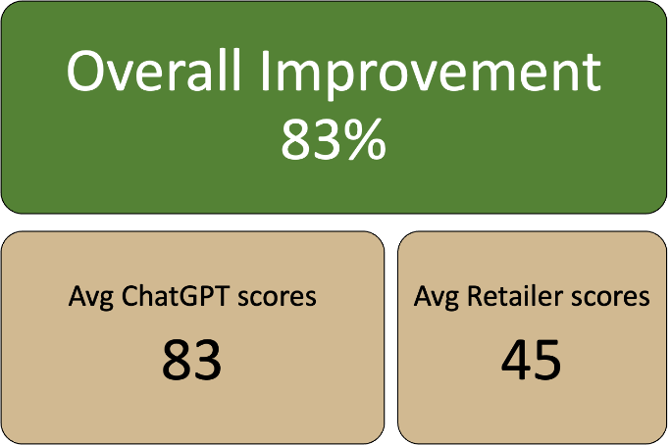
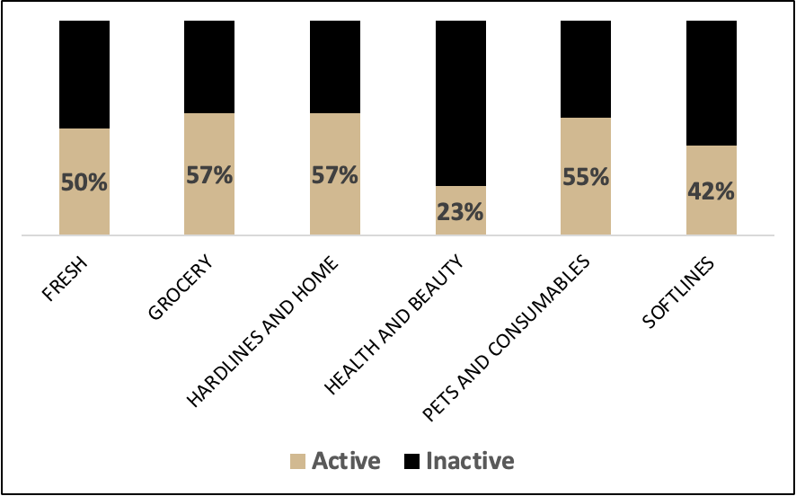
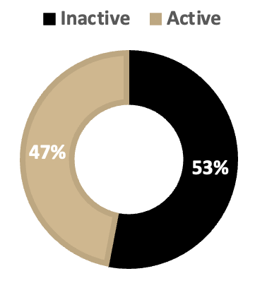
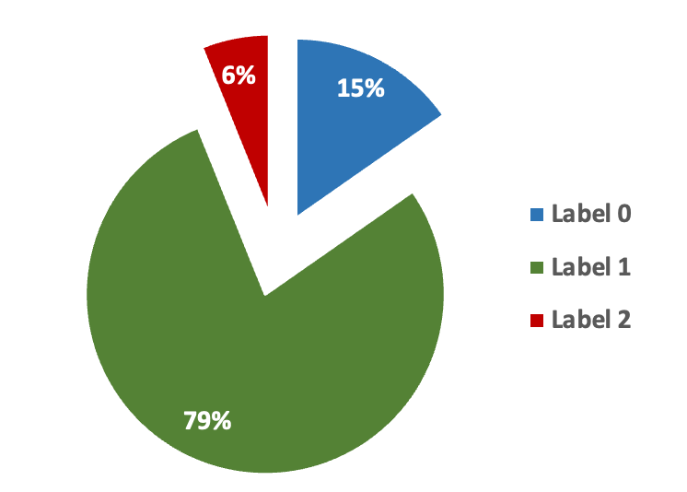


Unstructured Data Analysis to Improve Digital Eligibility of E-Commerce Listings
METHODOLOGY
Akshay Deshmukh, Anish Jasti, Nikhitha Siddi, Sharan Shirodkar, Suneet Abraham, Matthew A. Lanham
Purdue University, Daniels School of Business
deshmu25@purdue.edu; jastia@purdue.edu; nsiddi@purdue.edu; sshirodk@purdue.edu; abraha46@purdue.edu; lanhamm@purdue.edu
DEPLOYMENT & LIFE CYCLE MANAGEMENT
ANALYTICS PROBLEM FRAMING
We have identified two analytical problem goals to address the business problem –
The first goal is to develop an algorithm to score the descriptions on a scale of 100 to categorize them as ‘Good’ or ‘Poor’. Once we have identified the bad descriptions, we aim to correct them. The parameters we use to make this decision are readability, sentiment, length and relevance of the description. We assume only the above parameters to be pivotal in the segregation.
The second goal involves using Optical Character Recognition (OCR) to extract text from product images and using language model (OpenAI’s ChatGPT API) to generate descriptions for them.
Our success metrics are to increase digital eligible products and the percentage of ‘Good’ descriptions. We will focus solely on images with text and not consider object identification within the scope of this problem.
BUSINESS PROBLEM FRAMING
Our team is collaborating with a nationwide supercenter chain that mandates vendors to furnish product details along with at least one image for digital eligibility on their website. However, when vendors fail to comply with these requirements, numerous products are left unlisted on the client's website, causing an uneven customer experience.
The grocery chain's website only features products that meet specific requirements, and unfortunately, only 33% of the products in their portfolio fulfill these criteria, resulting in a loss of revenue.
The supercenter chain faces a limitation where vendors are unable to verify whether their product descriptions meet the required standards or not. Consequently, vendors tend to submit inadequate descriptions to pass the initial digital eligibility screening. To ensure uniformity and quality, there is a need to categorize descriptions appropriately.
Final Score
Dummy score
Readability
Relevance
Length
Sentiment
Grammar
Fig. 3 Methodology
Fig. 6 Benefit analysis of the project, taken for a million products
MODEL BUILDING
Conclusion –
The project used OCR, language model, and scoring algorithm to successfully improve the quality of product descriptions
Findings –
53% of products from subset of data were digitally ineligible for website listing
83% improvement in product description quality identified after using language model
Potential savings of 66%, 67%, and 63% in costs, labor, and time respectively
Limited improvement in Fresh category due to lack of textual information
Future Scope –
Increase revenue and improve customer experience by improving digital eligibility
Scoring algorithm can be used to improve search engine optimization for product listings
Success of the project can lead to collaborating between industry partners and academia
Fig. 2 Parameters for description scoring (right to left)
Fig 3. Methodology
DATA
Column | Description
ItemSku | Stock Keeping Unit
UPCTypeName | Universal Product Code Type
ProductName | Name of the product for internal purpose
MarketingName | Name of product listed on Meijer.com
MarketingDetails | Description of the product listed on Meijer.com
ItemURL | URL to the product image
Fig. 4 % Change (category-wise) in description scores
Our model shows an average of 83% improvement in the description score. There are still considerable cases mostly in case of ‘Fresh’ category, where the images do not have labels (no text) and it limits the ability of our model to generate a good quality description. This can be improved by encouraging the vendors to provide accurate descriptions
ACKNOWLEDGEMENTS
We would like to thank our industry partner for their guidance and support on this project as well as the Purdue MS BAIM program for partially funding this work.
Fig. 1 Category wise and overall split of eligible and ineligible products
Table 1 Data dictionary
Our model generated high-quality descriptions for 79% of the products in our dataset. For 15% of the products, such as fresh produce without labels, the retailer's descriptions were deemed more accurate and were used instead. The remaining 6% of the products had poor descriptions both from the retailer and our model and require correction by the vendor.
Our analysis of the provided data involves assessing the distribution of digitally eligible and ineligible products across various categories, as shown in Figure 1. Our findings indicate that 53% of the post EDA data is comprised of products that are ineligible to be listed on the retailer's website due to incomplete product information. The ultimate objective of our business is to reduce the percentage of inactive products.
The data is confidential and is provided to us by the supercenter chain. As a part of our pre-processing steps, we have eliminated any outliers in the product description length and have narrowed down the selection of columns to the ones required for our project.
ItemSku is the primary key for the data. ItemURL is the image URL for the products, and MarketingDetails is the column for the product description, which we use for our scoring algorithm.
Fig. 5 Split of different labels

